Slide 1
Gen-AI Overview

Slide 2
Content
What is Learning in Context of Machines
Broad Category of AI
Gen AI
ML
DL
Understanding key Terminologies
LLMs
Tokens
Embeddings
Prompting

Slide 3
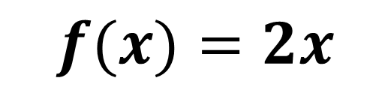

Learning in context of Machines
$$f(x)=y$$
X | f(x) = y
1 | 1
2 | 4
3 | 6
4 | 8
5 | 10
6 | 12
7 | 14
$$f(x)=2x$$

Slide 4
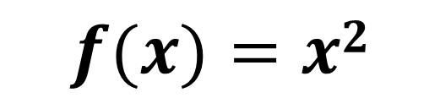
Learning in context of Machines
$$f(x)=y$$
X | f(x) = y
1 | 1
2 | 4
3 | 9
4 | 16
5 | 25
6 | 36
7 | 49
$$f(x)=x2$$
Learning the relation between the dependent variable and independent variable

Slide 5
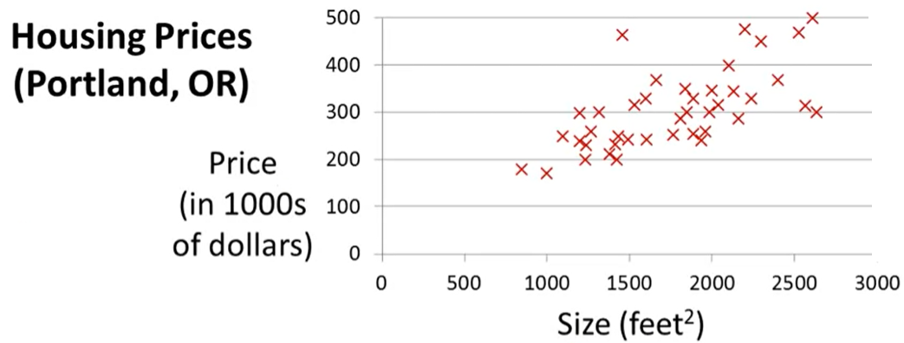
Learning in context of Machines

Slide 6
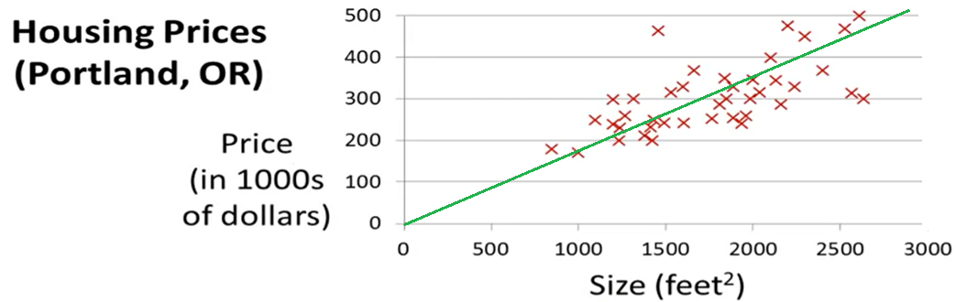
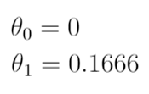
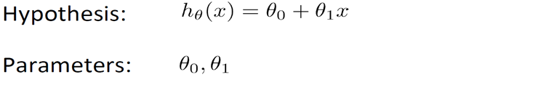
Learning in context of Machines

Slide 7
Learning in context of Machines
Size | Price
1500 | 249
1800 | 300
2000 | 333

Slide 8
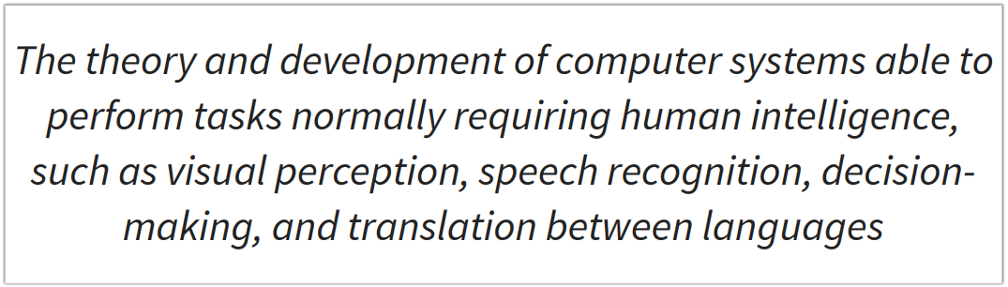
What is AI (Oxford Dictionary)

Slide 9
Generative AI = Generative + AI

Slide 10
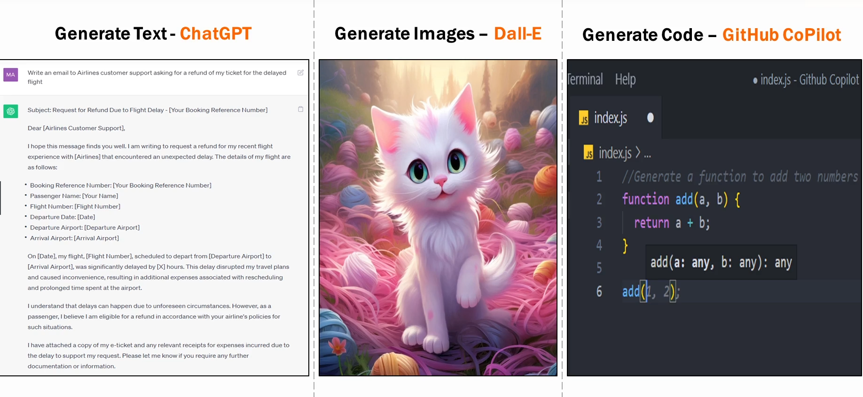
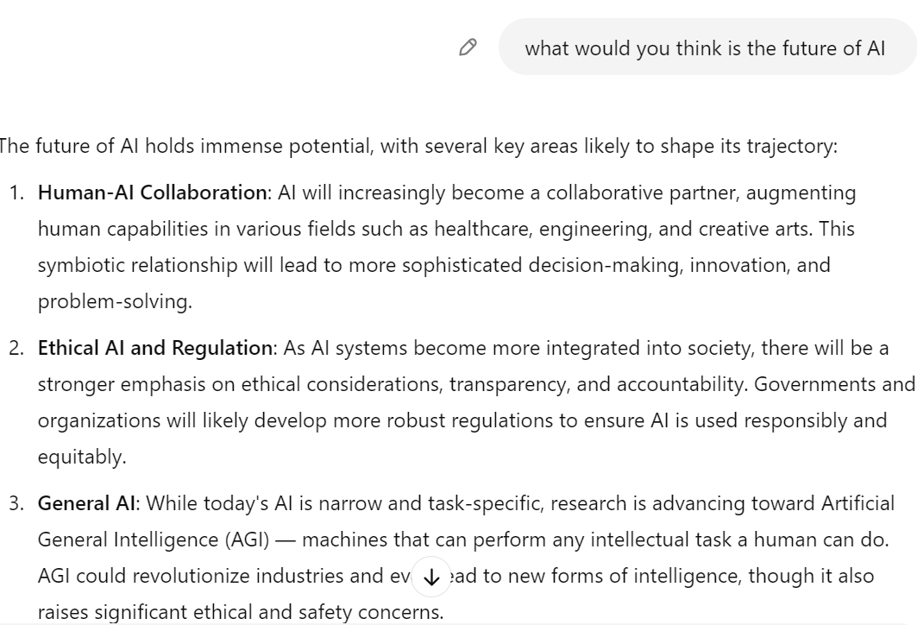
Generate Text-
ChatGPT
Generate Image-
Dall-E
Generate Image-
Github Copilot

Slide 11
Generative AI is a type of AI that can create new content, such as audio, images, text, code, videos etc.

Slide 12
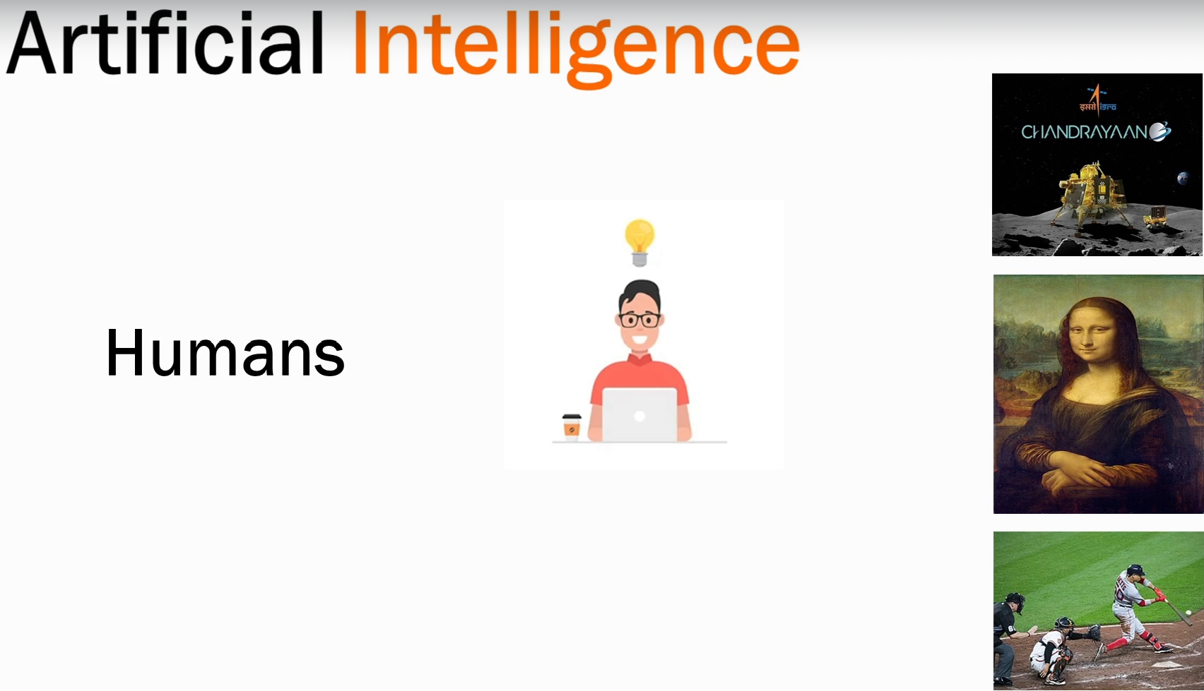

Slide 13


Slide 14
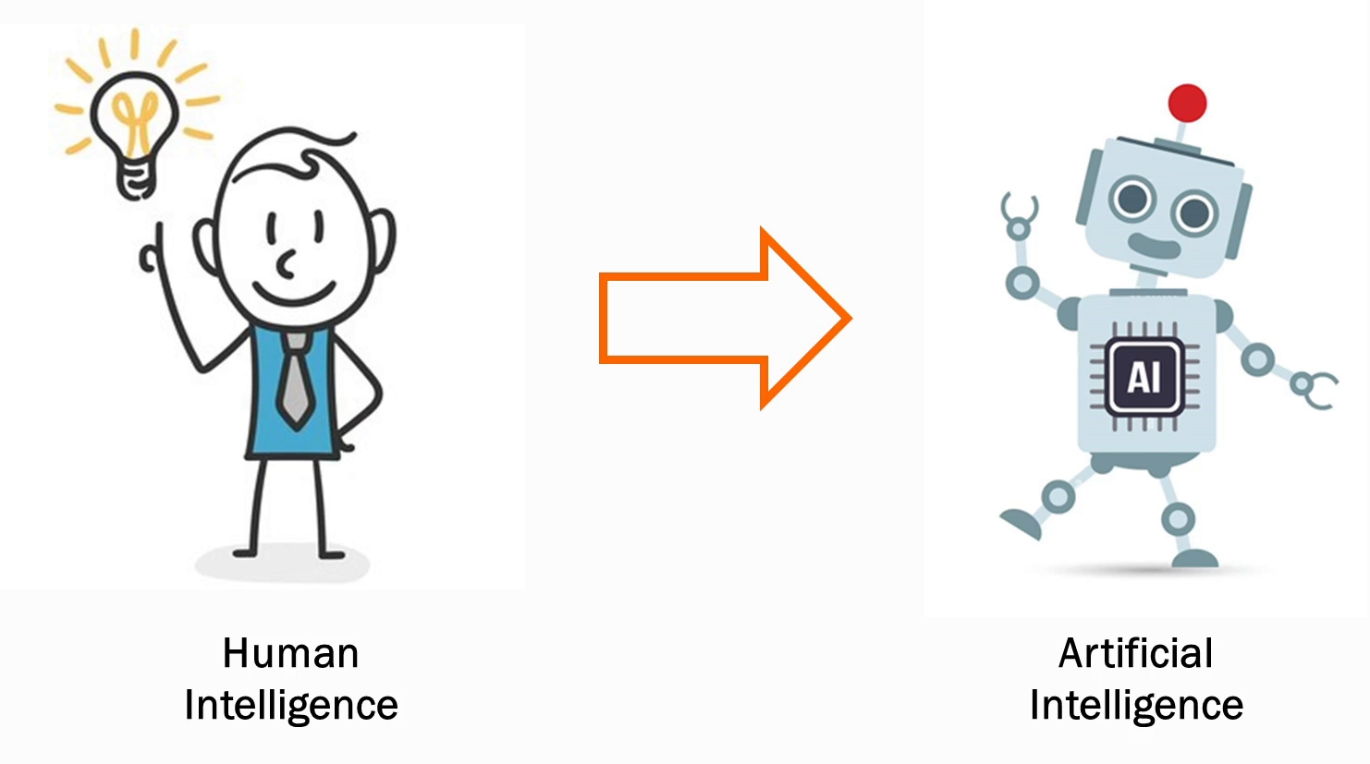

Slide 15
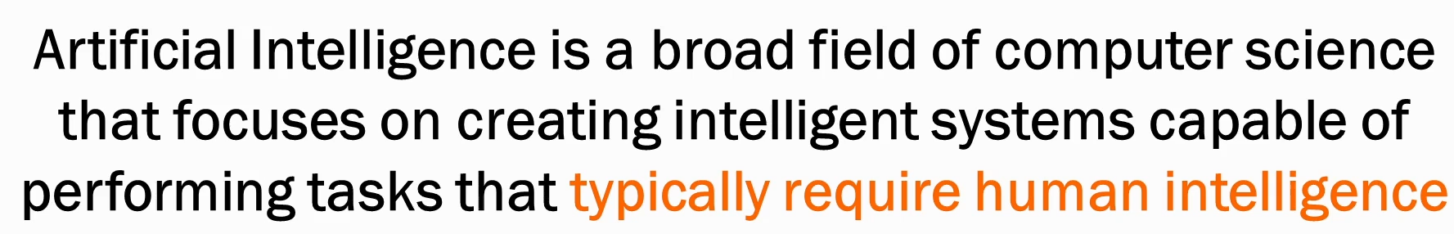

Slide 16


Slide 18


Slide 19
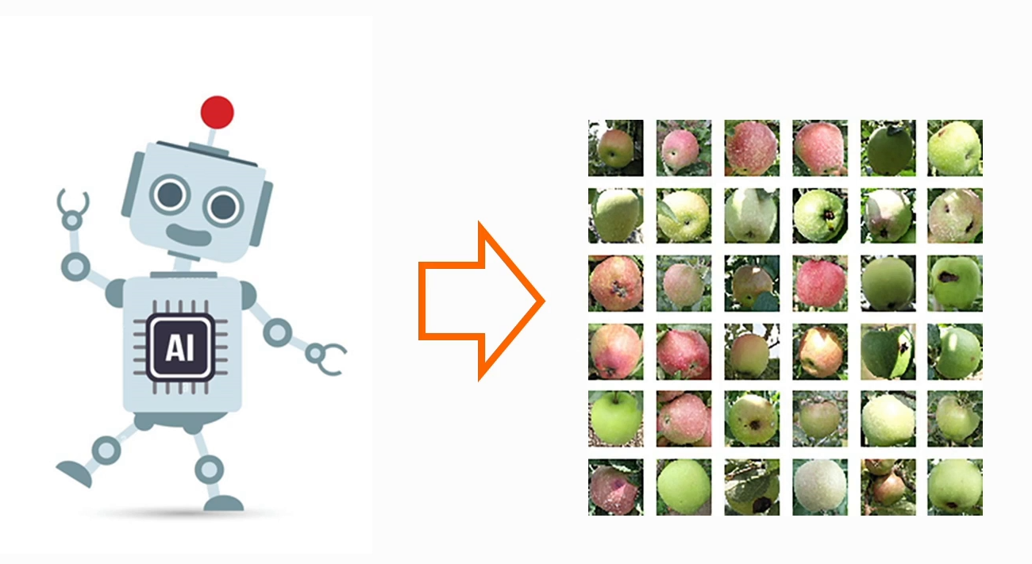

Slide 20


Slide 21
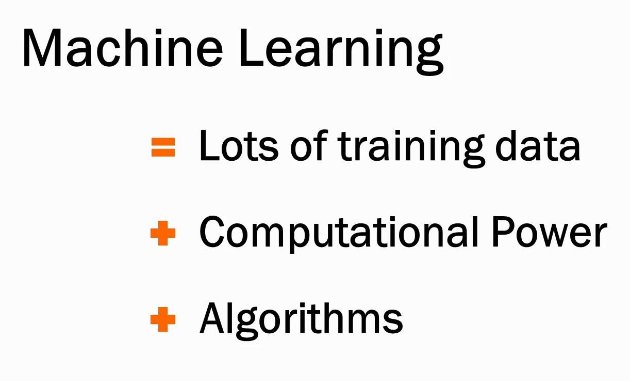

Slide 22
Deep Learning

Slide 23
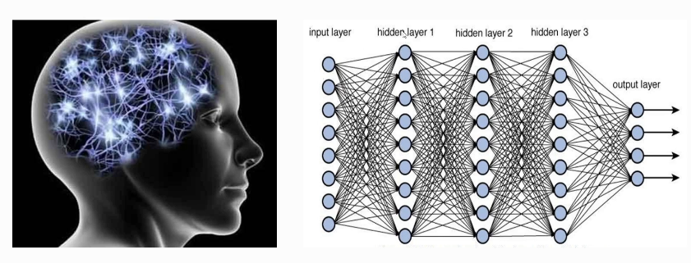
Deep Learning

Slide 24
Deep Learning

Slide 25
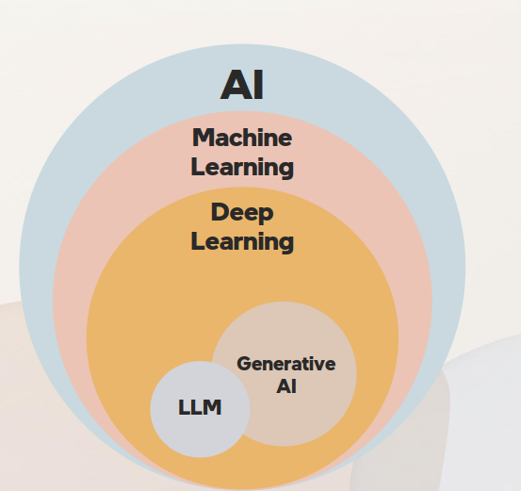

Slide 26
Key Terminologies
LLMs

Slide 27
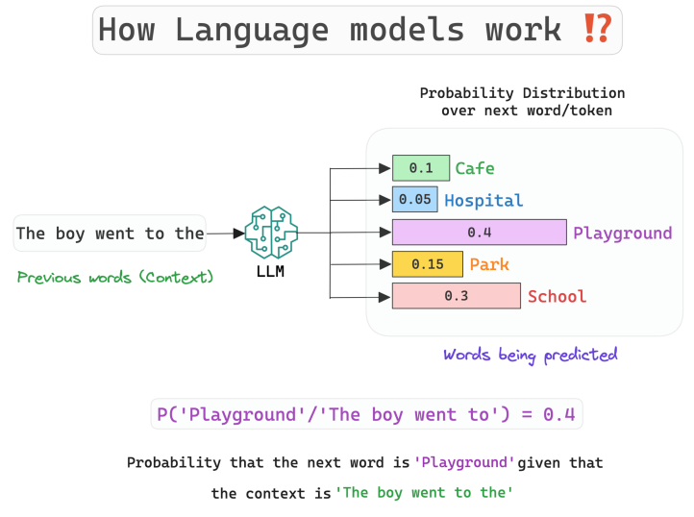

Slide 28
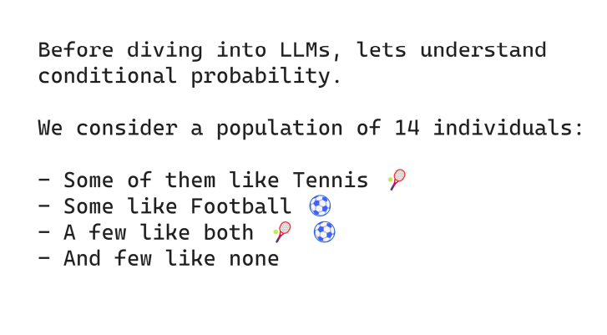

Slide 29
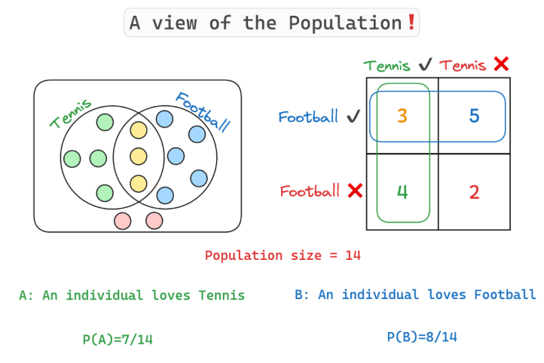

Slide 30
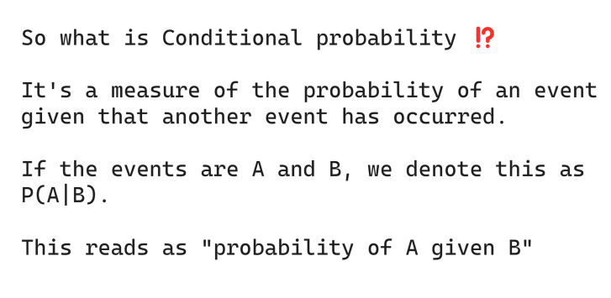

Slide 31
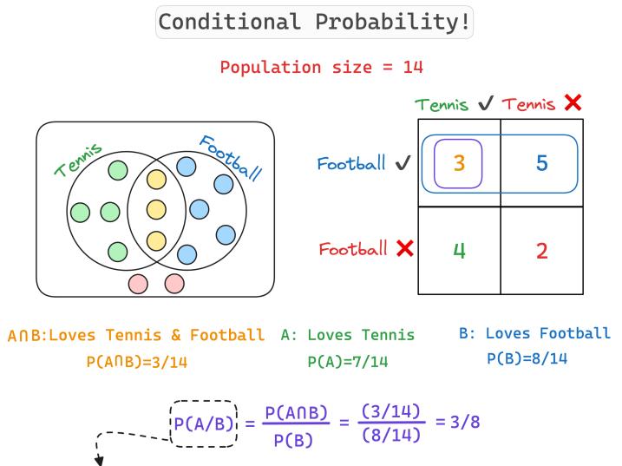
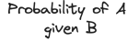

Slide 32
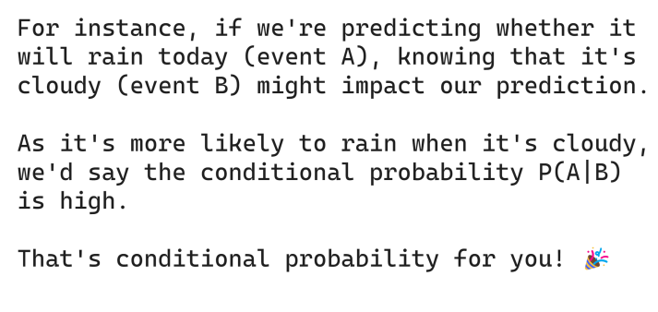

Slide 33
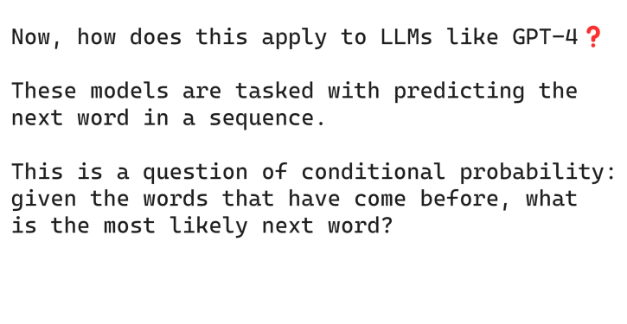

Slide 34
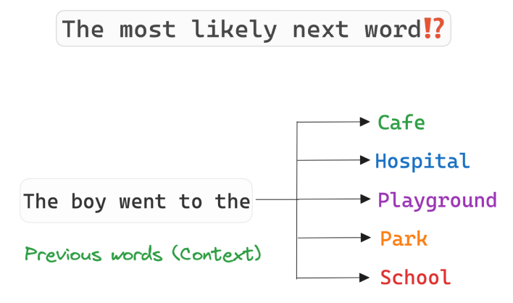

Slide 35
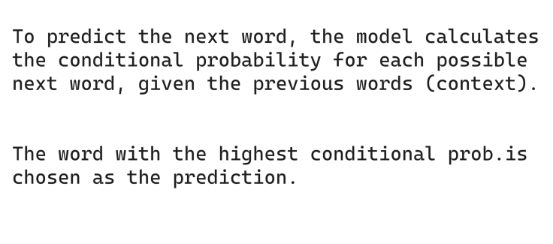

Slide 36
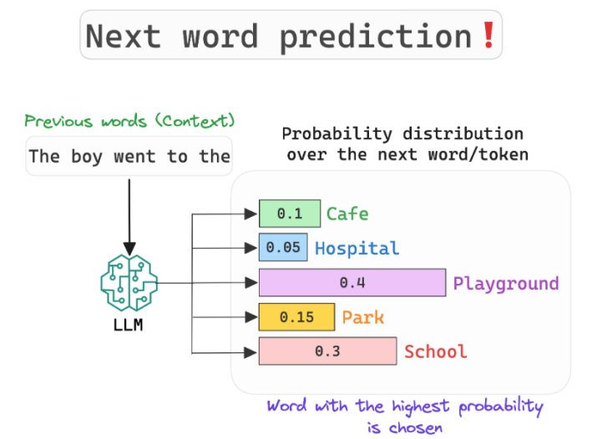

Slide 37
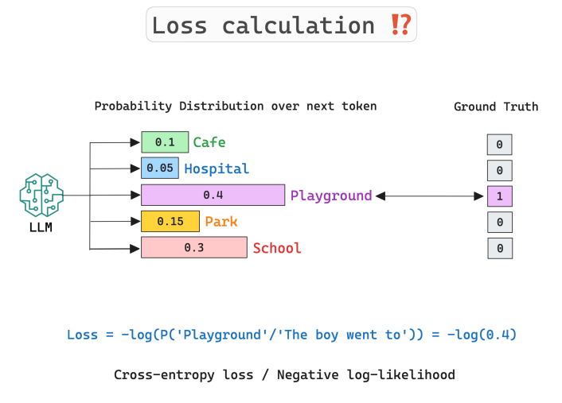

Slide 38
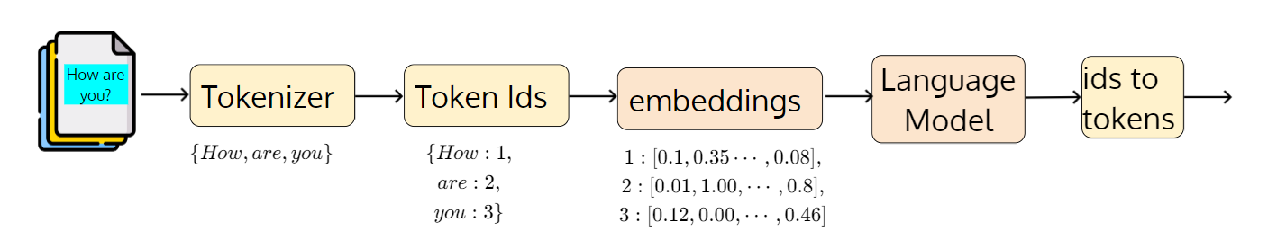
Tokens

Slide 39
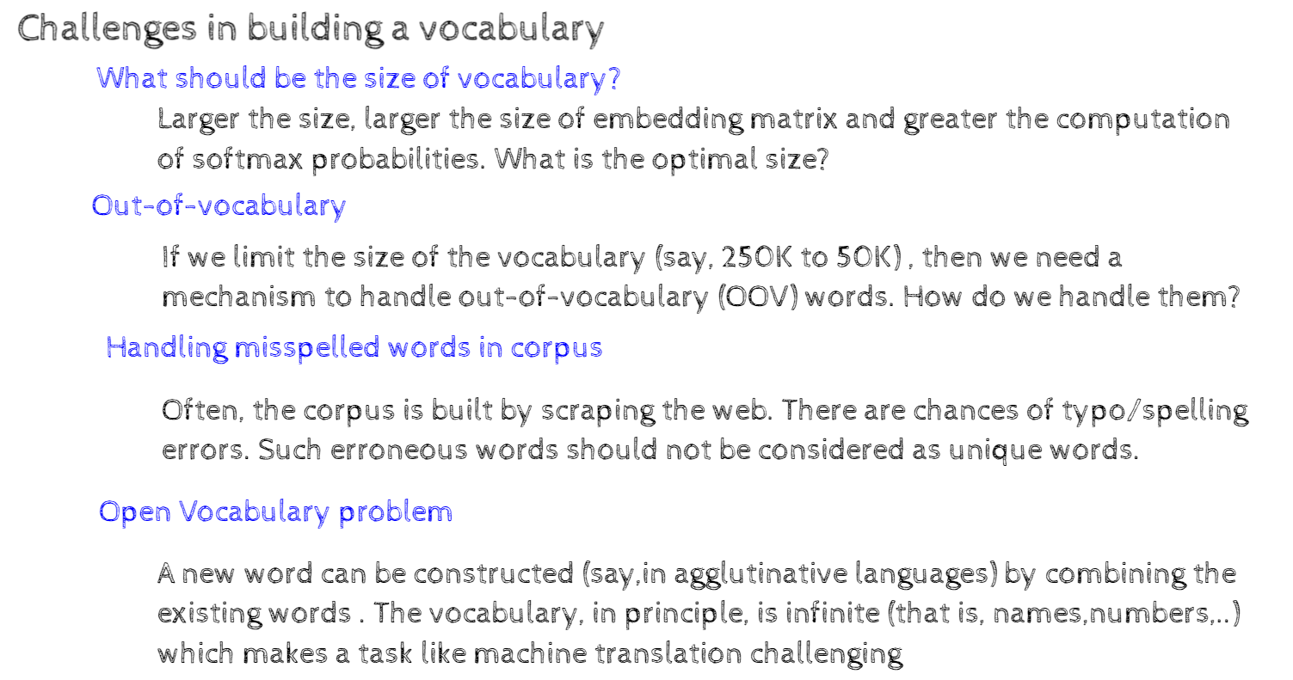
Tokens

Slide 40
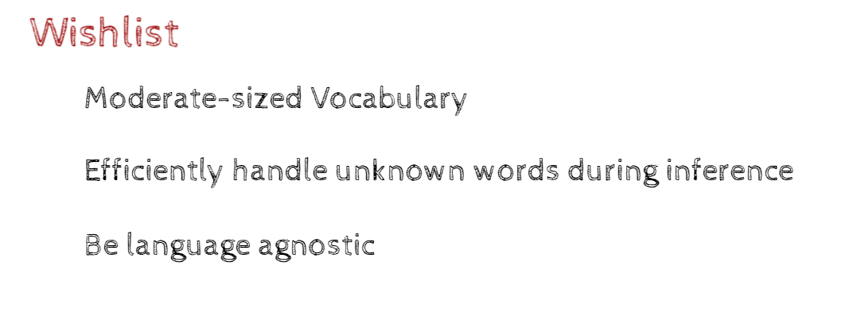
Tokens

Slide 41
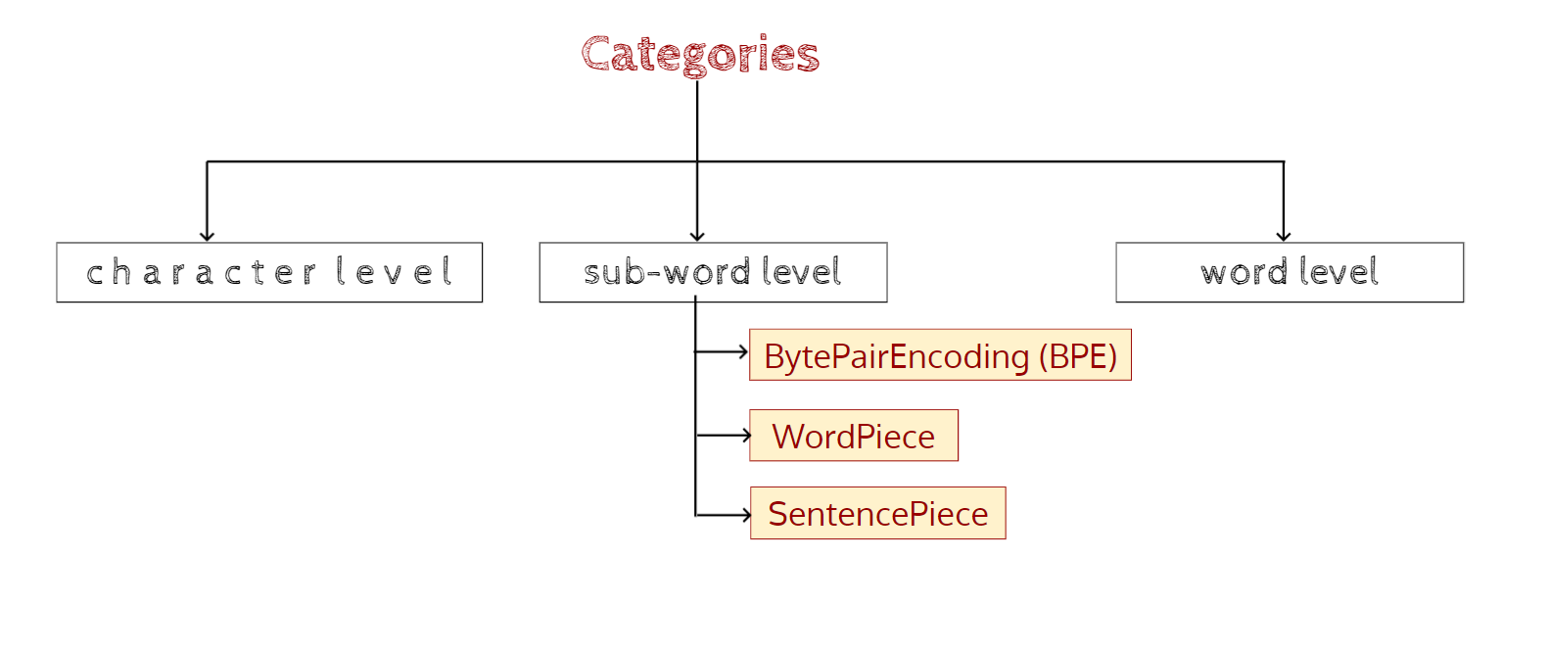
Tokens

Slide 42
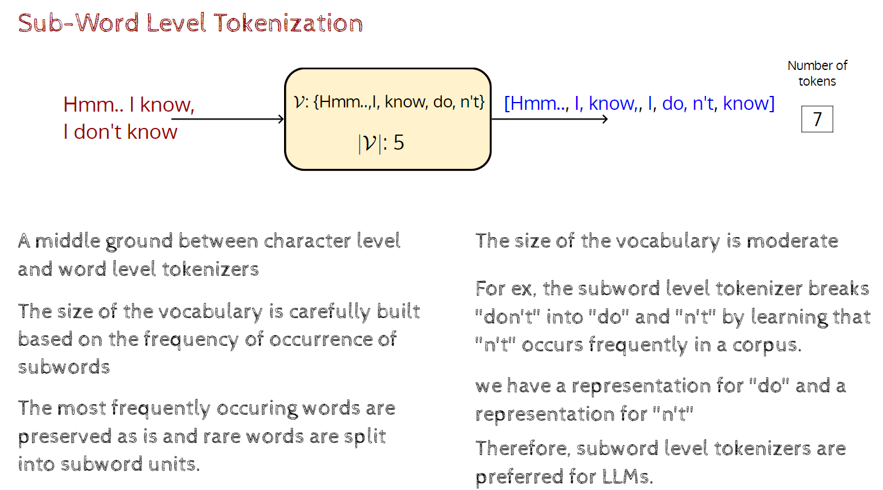
Tokens

Slide 43
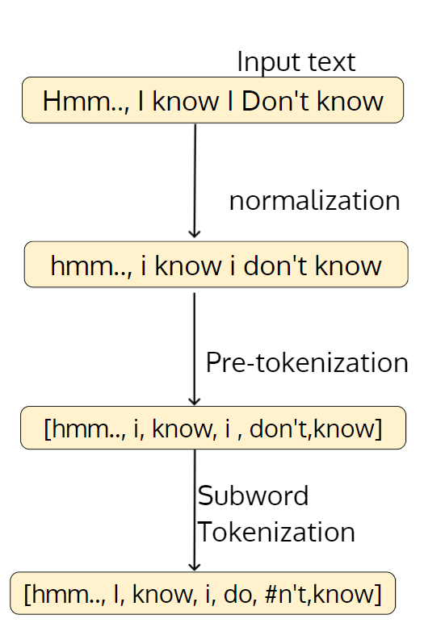
Tokens

Slide 44
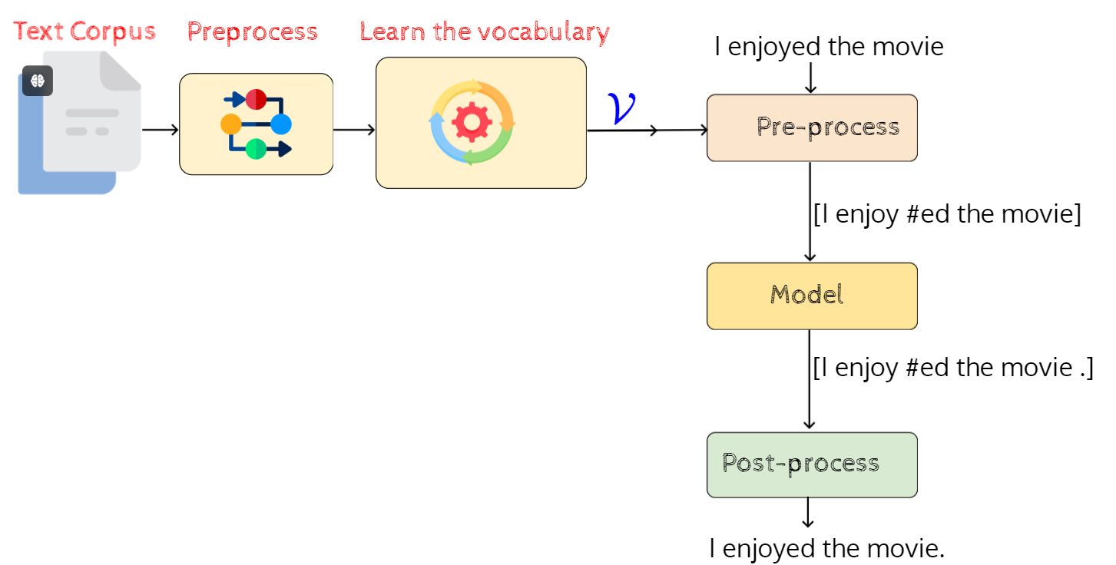
Tokens

Slide 45
Tokens: Example
https://platform.openai.com/tokenizer

Slide 46
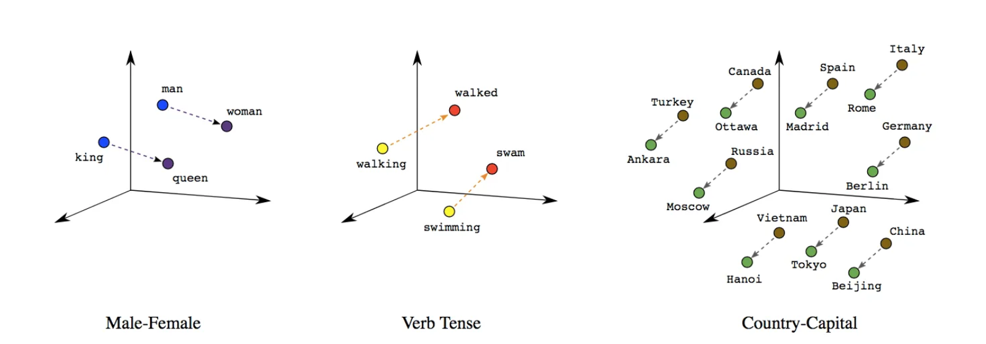
Embeddings

Slide 47
Embeddings
king – man + woman = queen

Slide 48
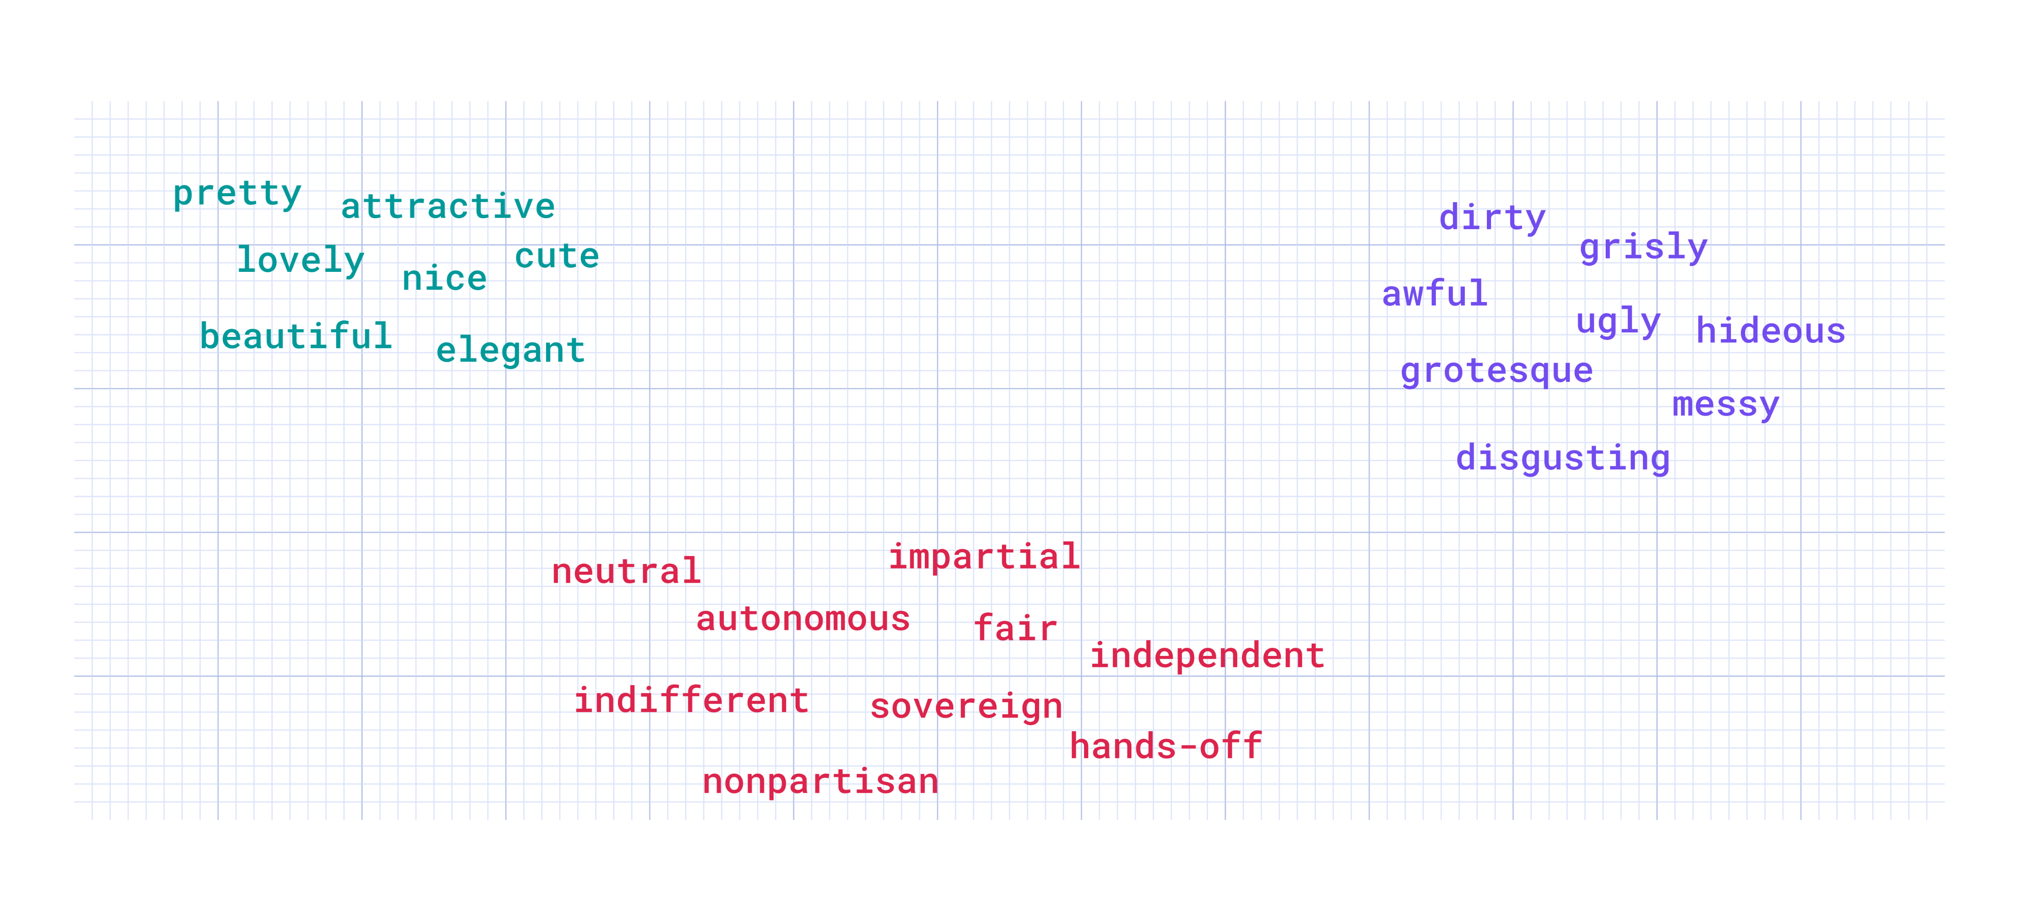
Embeddings

Slide 49
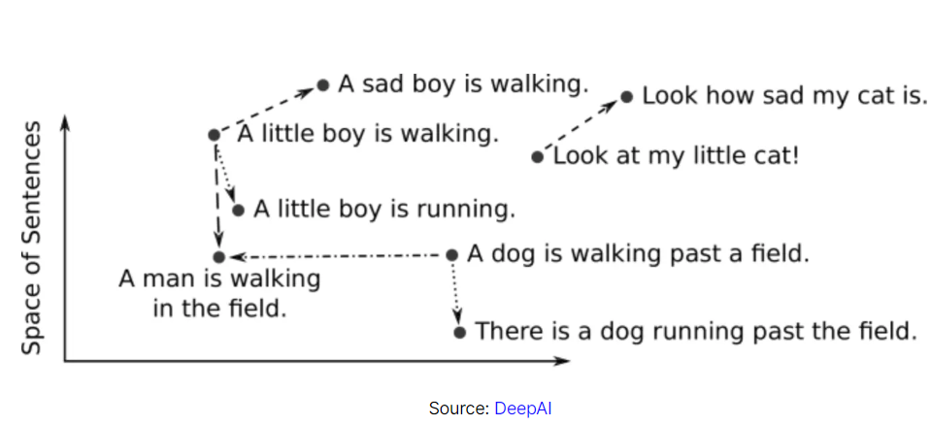
Embeddings

Slide 50
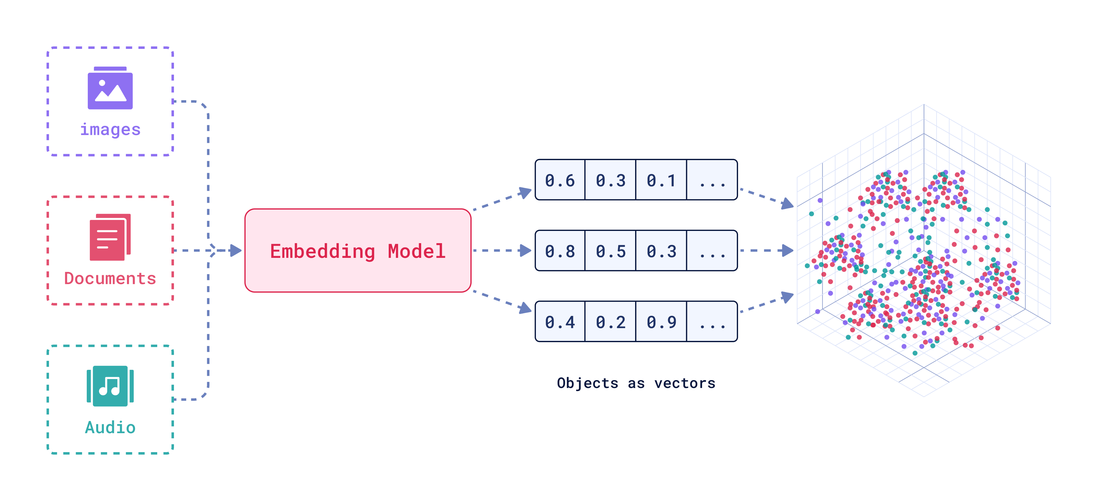
Embeddings
Embeddings

Slide 51
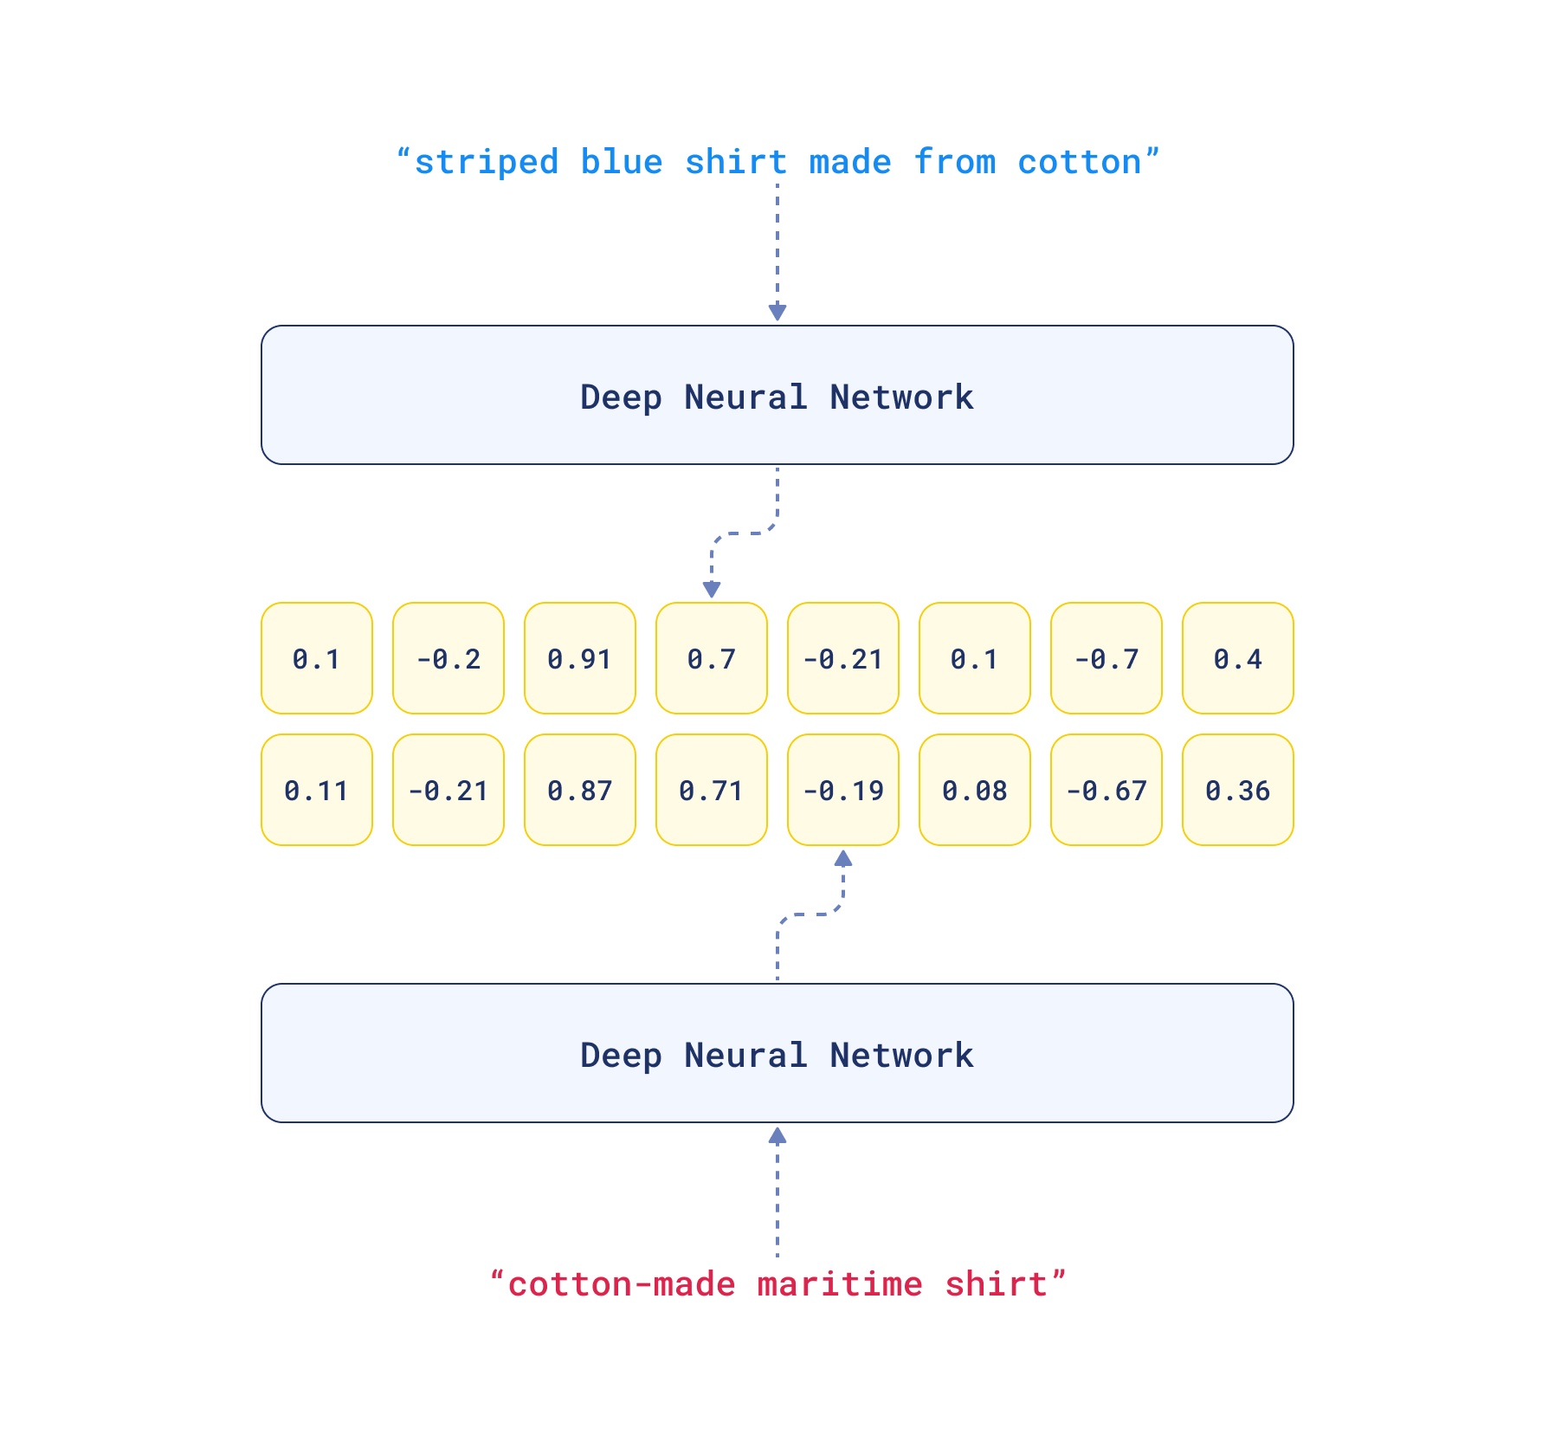
Embeddings

Slide 52
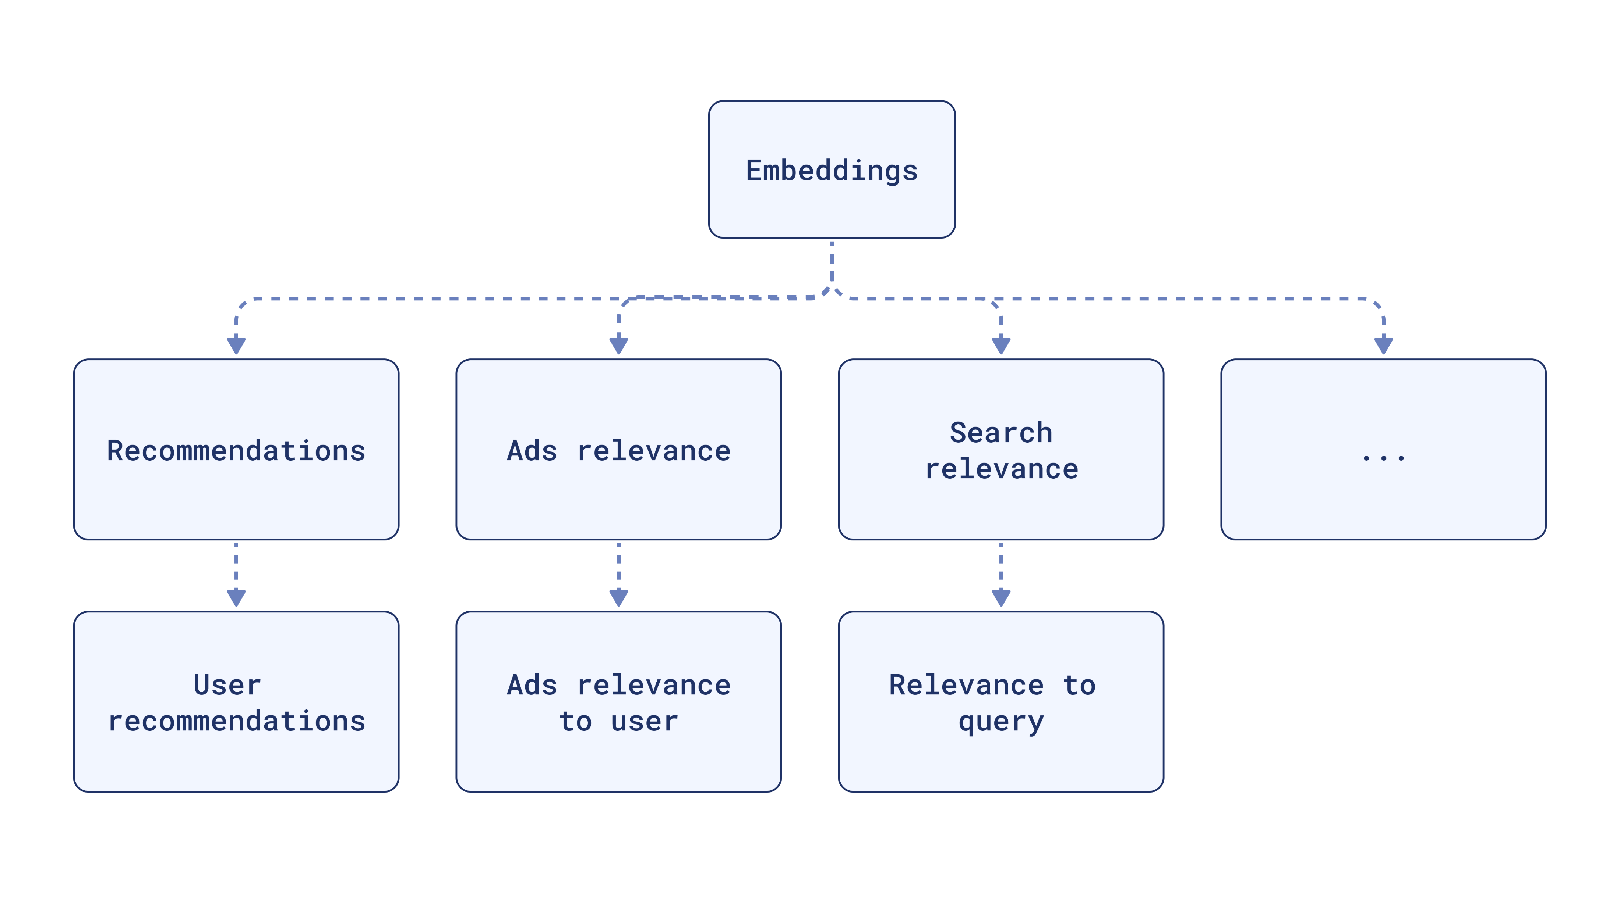
Embeddings

Slide 53
https://masteringllm.medium.com/demystifying-the-temperature-parameter-a-visual-guide-to-understanding-its-role-in-large-language-d9e8ea4b9956
https://www.linkedin.com/posts/latha-t-k-b21018128_how-llm-work-pdf-ugcPost-7214212918530228224-e1Gw?utm_source=share&utm_medium=member_desktop
https://qdrant.tech/articles/what-are-embeddings/

